Slide 1
Stealth Leadership
ALA Central Florida
June 28, 2017

Slide 2
Definitions
Stealth
  Moving carefully and quietly, to avoid being seen.
  Act of moving, proceeding, or acting in a covert way.
Leadership
  Position or function of a leader.

Slide 3
Qualities
Credit doesn’t matter
Bring it on
Reliable, dependable, accountable
All-in

Slide 4
Success or Failure?
20%
Attitude
Skills
Knowledge
60%
20%
If you don’t know where you are going, any road will get you there.
- Alice in Wonderland

Slide 5
Components of Stealth Leadership
1) Communication
Understandable
You had me at ‘hello’
93% Non Verbal
Body Language
Actionable
Relevant
Intention to connect
Timely
Eye Contact

Slide 6
Components of Stealth Leadership
2) Talent Development
People are the differentiator
Physical Skills (IQ) | Mental Skills (EQ)
Word Processing | Communication
Spreadsheets | Presence
Filing | Attitude

Slide 7
Components of Stealth Leadership
3) Strategy & Succession
Can’t “make” them do it!
What’s your plan?
3 - 5 years ahead
Coverage now
Exit strategy

Slide 8
Components of Stealth Leadership
4) Accountability
Create it –
For yourself
Build it in your culture -
With others

Slide 9
Raising Accountability
Clear vision and priorities
Shared ownership
Resolve conflicts and problems
Continually develop trust
Effective execution
Relentless pursuit of growth/improvement
Celebrate wins

Slide 10
Inspiration or Perspiration?
Are you afraid to fail?
      or
Are you afraid to succeed?

Slide 11

Questions?

Slide 12
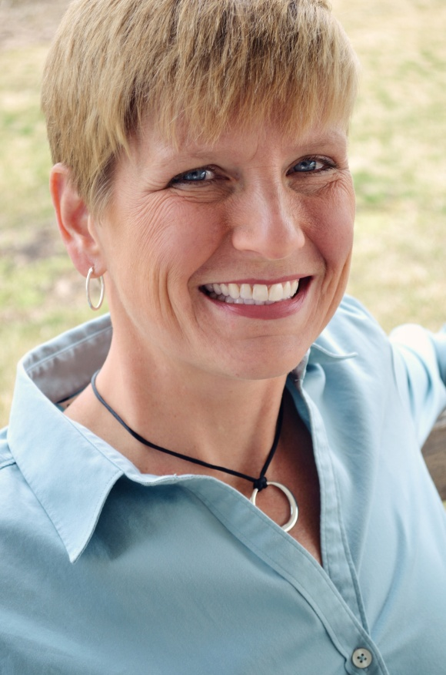




About the Speaker
Judy Hissong is the President and founder of Nesso Strategies. With over 15 years experience inside professional service organizations, she brings a wealth of knowledge and expertise in leadership, Emotional Intelligence, and strategic planning. A lifelong learner, professional coach, and athlete she partners with law firms to maximize performance – in strategic planning, leadership growth and team development.
619.546.7885
www.linkedin.com/in/judyhissong/
Judy@NessoStrategies.com
@judyhissong

